Slide 1
Song Recommendation System
Presented By Group 4
Kavya Javai
Nandakishore Boini
Spoorthi Prasad
Sahil Ruhil
Tehefiz
Ubed M A

Slide 2
Dataset Overview – Generated Using Faker
Faker is a Python library used to generate realistic synthetic data for testing and machine learning models.
We used Faker to create a song dataset with 15,000 rows and 10 columns for our Song Recommendation System.
Dataset Summary
Total Rows: 15,000 Total columns: 10
Dataset Structure
Category | Columns | Description
🎶 Song Information | Song_ID, Song_Name, Artist, Genre, Duration, Release_Year | Details about songs in the dataset
👥 User Interaction | Popularity, User_ID, User_Rating, Timestamp | Data on user engagement and ratings

Slide 3
Exploratory Data Analysis (EDA)
1
2
3
4
5
CONVERSION OF DATA TYPE
ZERO NULL VALUES IN THE COLUMNS
ZERO DUPLICATE VALUES IN THE CIOLUMN
NORMALLY DISTRIBUTED DATA
ZERO OUTLIERS IN THE COLUMNS
THE TIMESTAMP COLUMN WAS IN OBJECT DATATYPE CONVERTED IT INTO DATETIME DATATYPE
CHECKED FOR THE NULL VALUES IN THE COLUMNS NO NULL VALUES FOUND
CHECKED FOR THE DUPLICTAE VALUES IN THE COLUMNS NO DUPLICATE VALUES FOUND
DATA IS NORMALLY DISTRUBTED ,NO SKWENESS FOUND
CHECKED FOR THE OUTLIERS AND FOUND THAT THERE ARE NO OUTLIERS

Slide 4
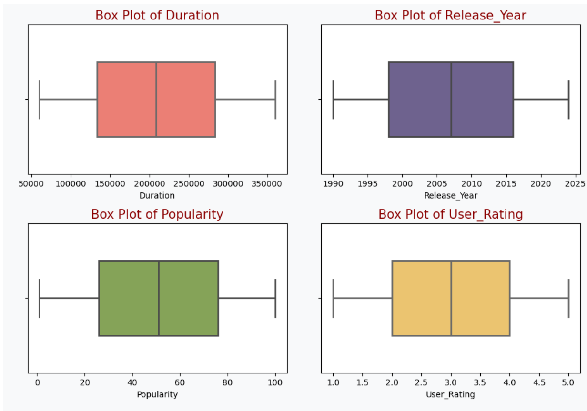
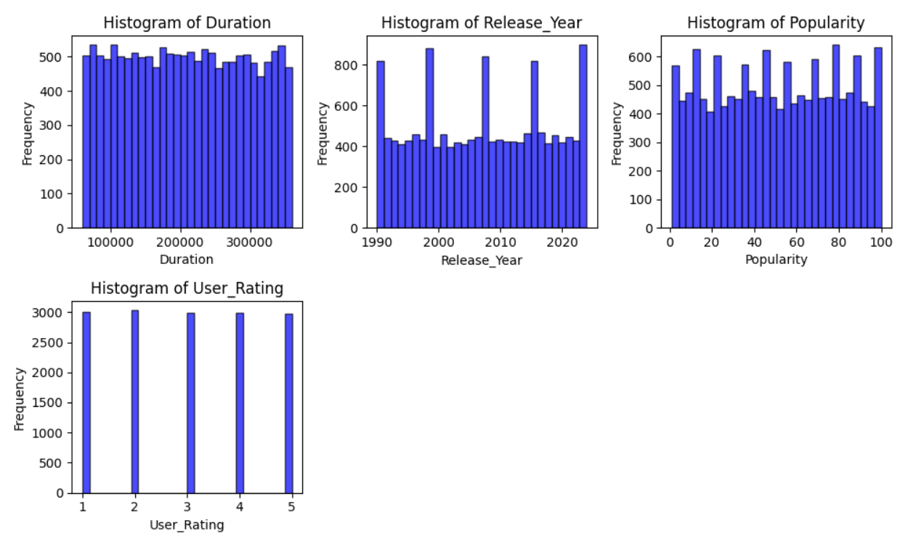
HISTOGRAMS AND BOXPLOTS
We plotted histograms to check skewness and found that the data is normally distributed.
We used boxplots to detect outliers and confirmed that there are no major outliers in the dataset.

Slide 5
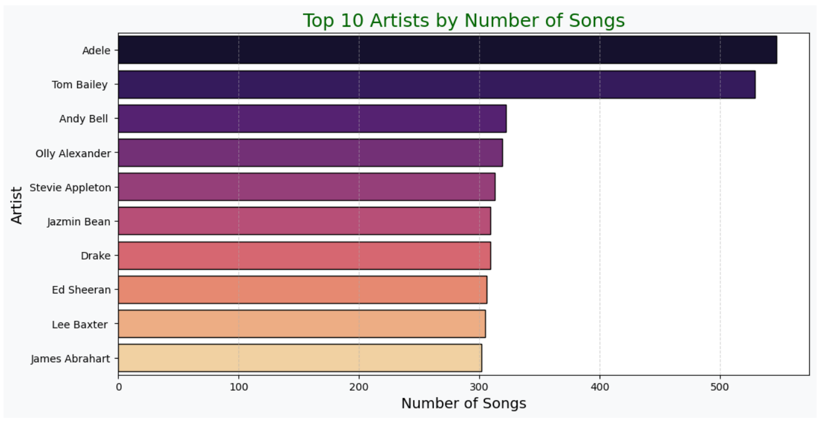
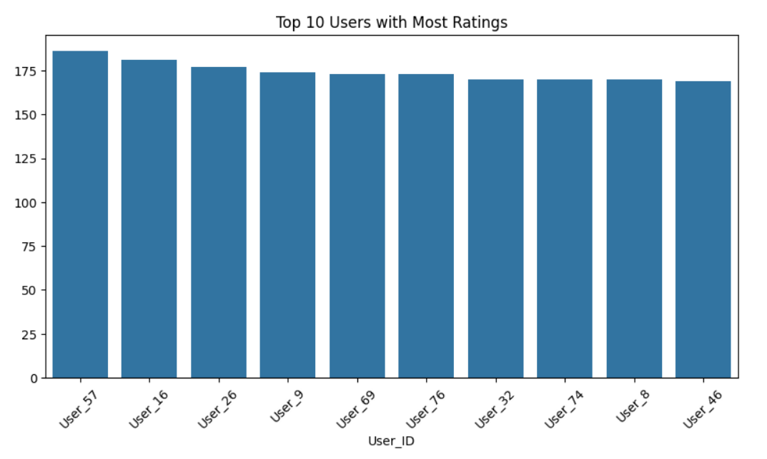
Data Visualization
Top 10 Artists by Number of Songs
Top 10 Users with most Ratings

Slide 6
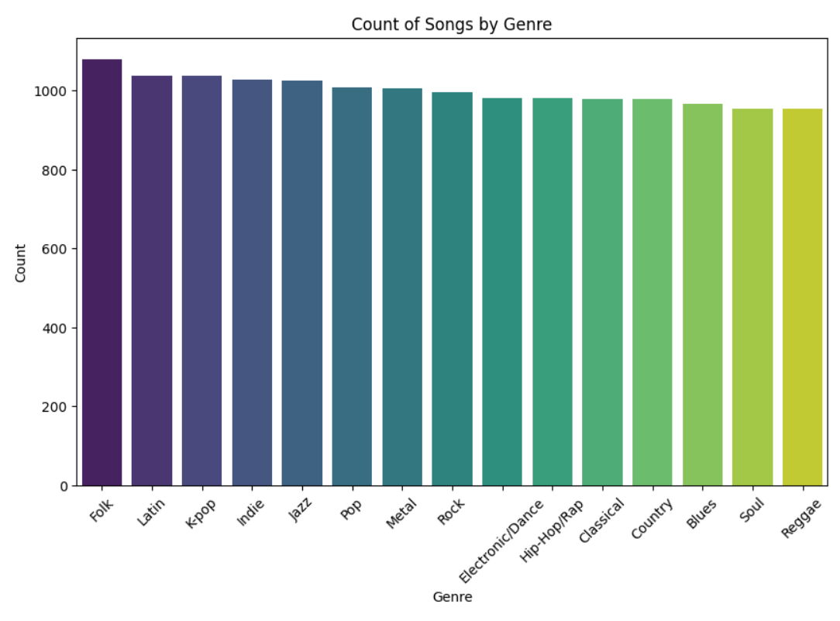
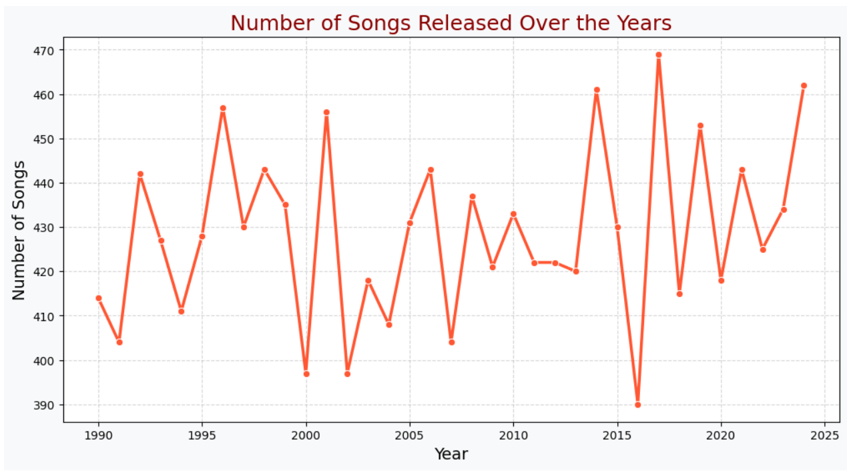
Number of songs Released over the years
Count of songs by Genre

Slide 7




Model Building
1.Collaborative based model
2.Content based model
3.Hybrid based model
Collaborative filtering leverages user behavior. This method identifies similar users and songs.
User ratings and listening history are vital. This data helps make personalized recommendations.
1
Recommendations
2
Similar Users
3
User Preferences
4
Data Collection

Slide 8



Content Based Model
Content-based filtering matches songs by attributes. It recommends songs similar to those a user likes.
This method uses extracted features from the songs. It relies on metadata and audio features.
Matching Songs by Characteristics
Features
Extract song features (genre, tempo)
Profile
Build user profile of liked features
Match
Recommend songs matching the profile

Slide 9



Hybrid Based Model
A hybrid approach combines collaborative and content-based filtering. This leverages the strengths of each.
This often results in more accurate recommendations. It addresses limitations of individual methods.
Content
2
Song metadata and extracted characteristics
Collab
User data and song listening history
1
Hybrid
3
Combined recommendations, tailored to user taste

Slide 10
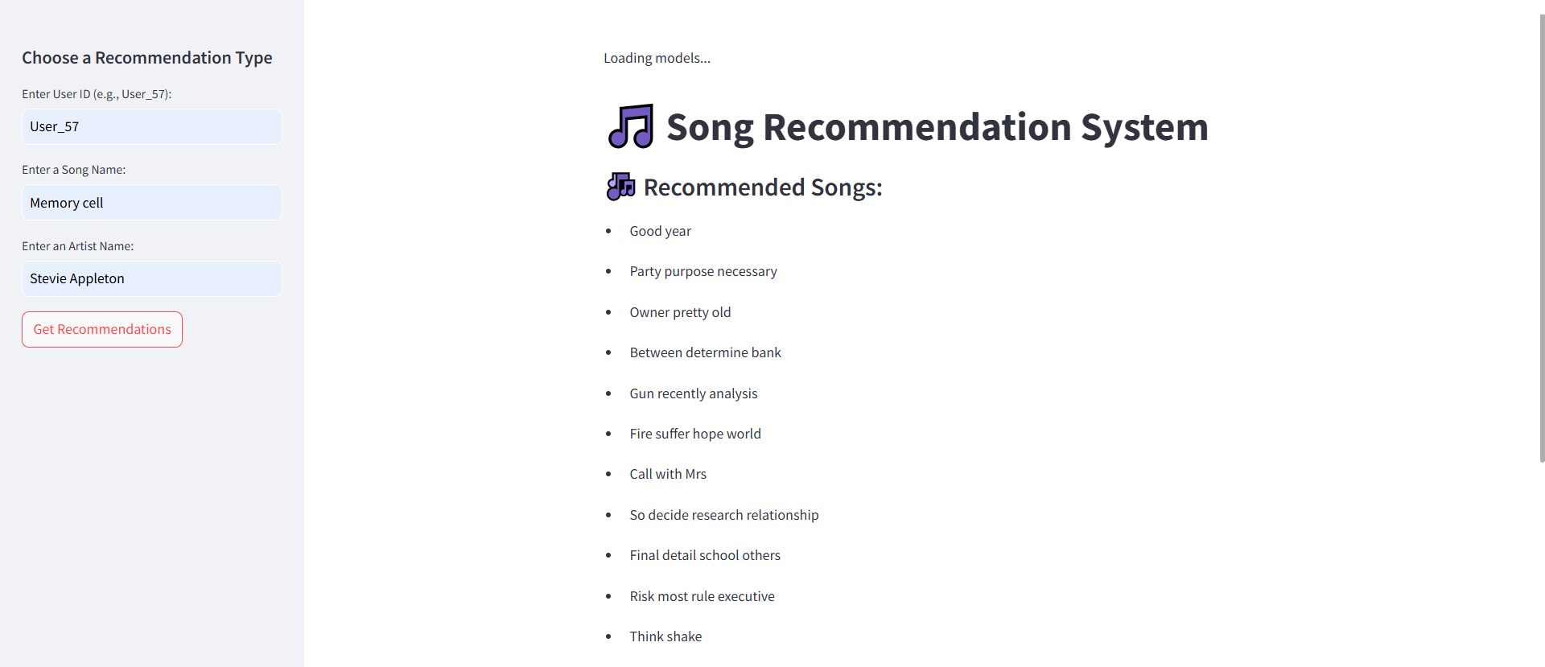
DEPLOYMENT

Slide 11
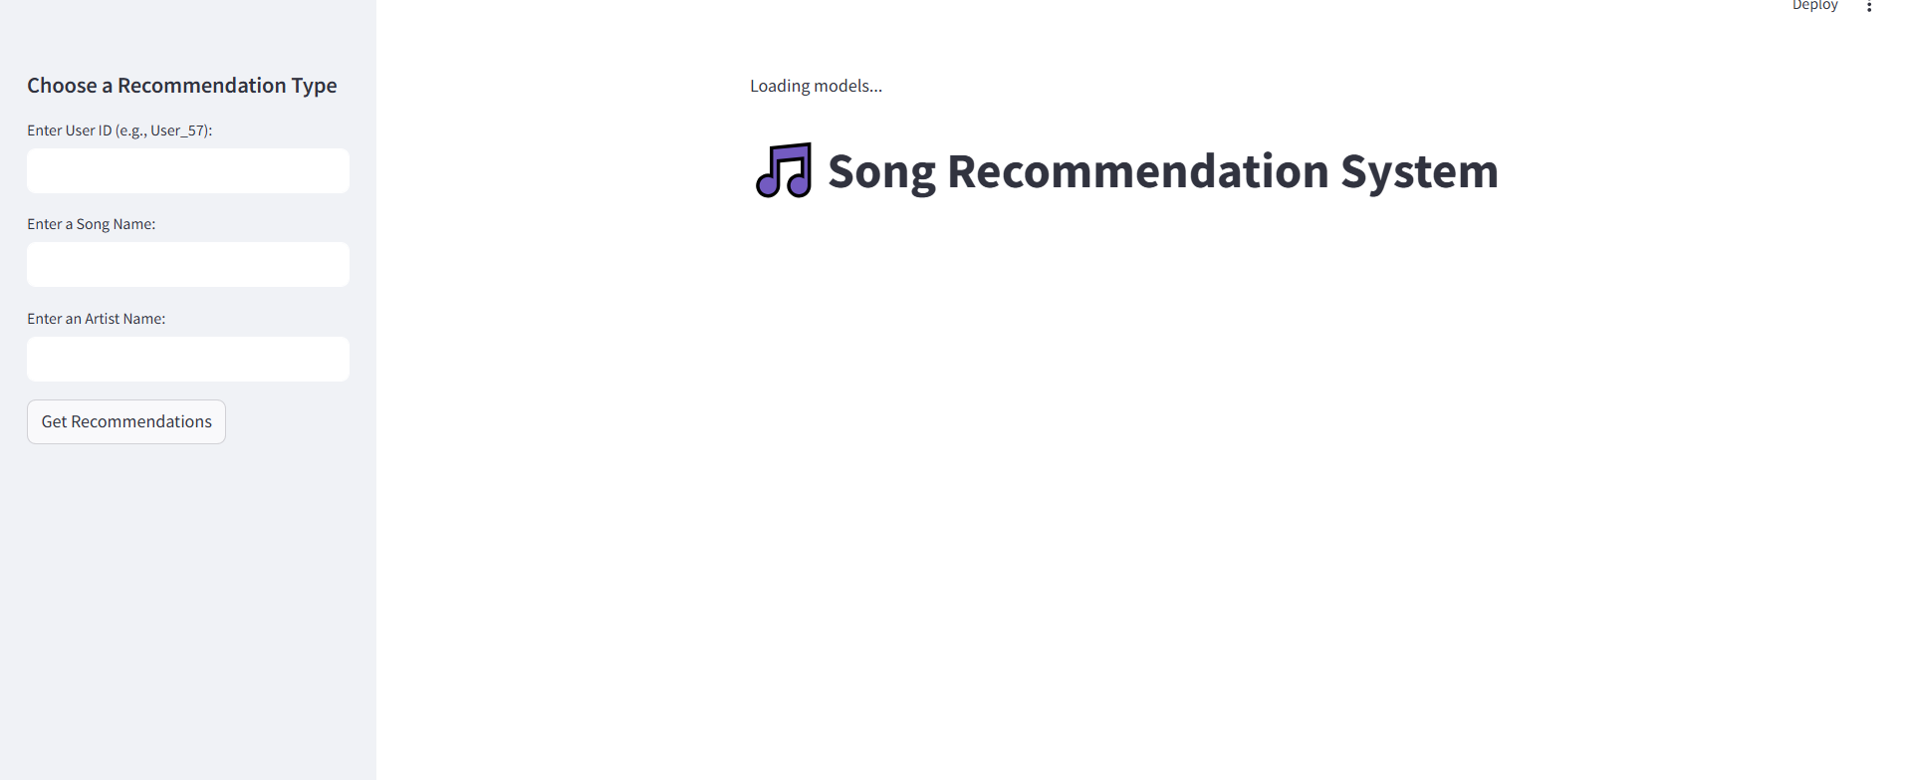

Slide 12
Challenges Faced in the Project
Data Collection – Generating a realistic and diverse dataset using Faker while ensuring it mimics real-world music data.
Data Confusion – Handling inconsistencies in artist names, genres, and duplicate songs, which affected data accuracy.
Model Selection and Building – Choosing the right recommendation models such as content-based, collaborative filtering, and hybrid, and fine-tuning parameters for better results.
Cold Start Problem – Difficulty in recommending songs for new users or newly added songs with no prior interaction data.
Scalability Issues – Ensuring the model performs efficiently when handling large datasets with thousands of songs and users.
Deployment Challenges – Integrating the model with Streamlit while optimizing speed and user experience.

Slide 13
THANK YOU

